Slide 1
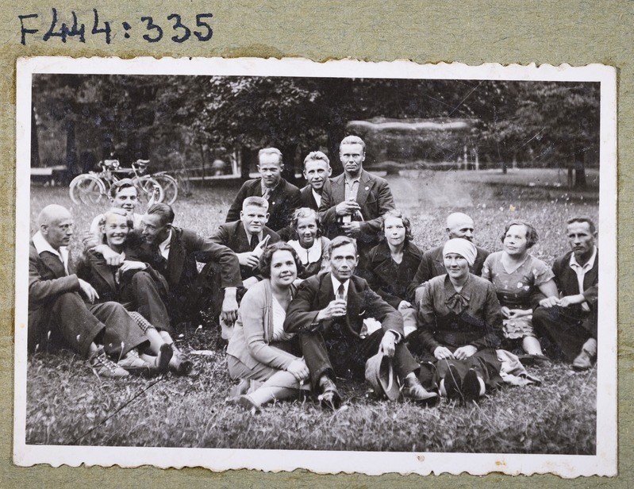
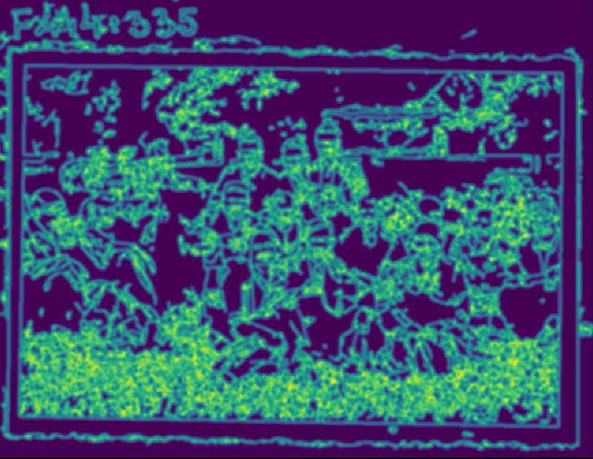

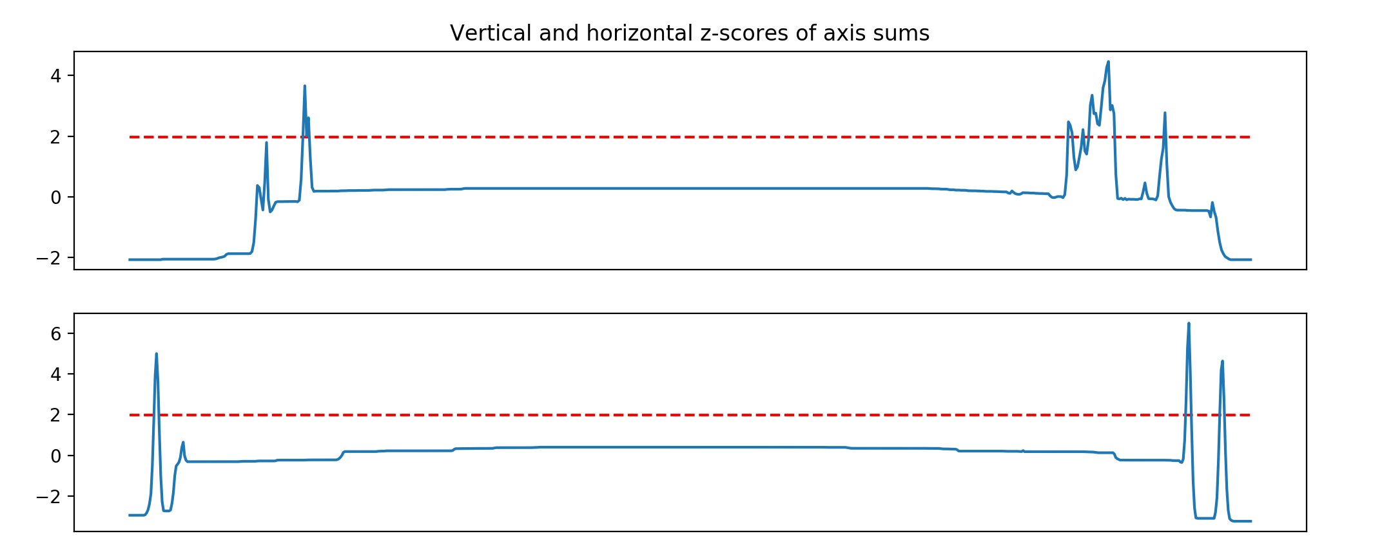
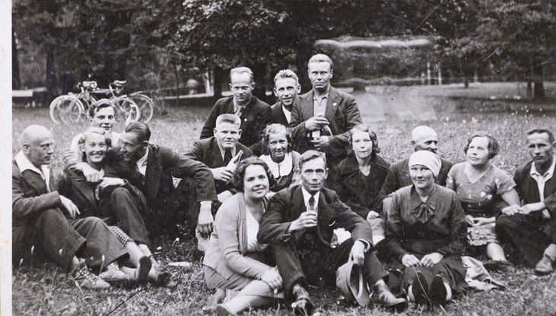
Cropping frames from images
Alvin Meltsov, Hain Zuppur
University of Tartu
2019
Introduction
1
Data
Image denoising using non-local means denoising
2
3
4
Methods
Image processing was done using Python libraries cv2, numpy, and scipy. The script crops the frames from images in following steps:
Applies non-local means denoising, which makes the picture blurred, but leaves stronger lines sharper.
Applies Canny edge detection with low threshold to detect both horizontal and vertical edges with Sobel kernel.
Filter out lines that can be found only upwards or sideways or rotate until such lines are found for both directions.
Threshold the found images by calculating z-scores over both axes and selecting the nearest suitable coordinate to the center of given axis.
Rotate and crop the original image with found coordinates.
5

